Slide 1



KIN MOBILE APPLICATION
BY:
TOKA EMAD
EMAN WAHDAN
OSAMA MAHMOUD
AMR ALAAELDIN
TO:Dr. sherine Abd Elkader

Slide 2

INTRODUCTION
Kin is a mobile application that helps us join groups related to our interests easily .

Slide 3
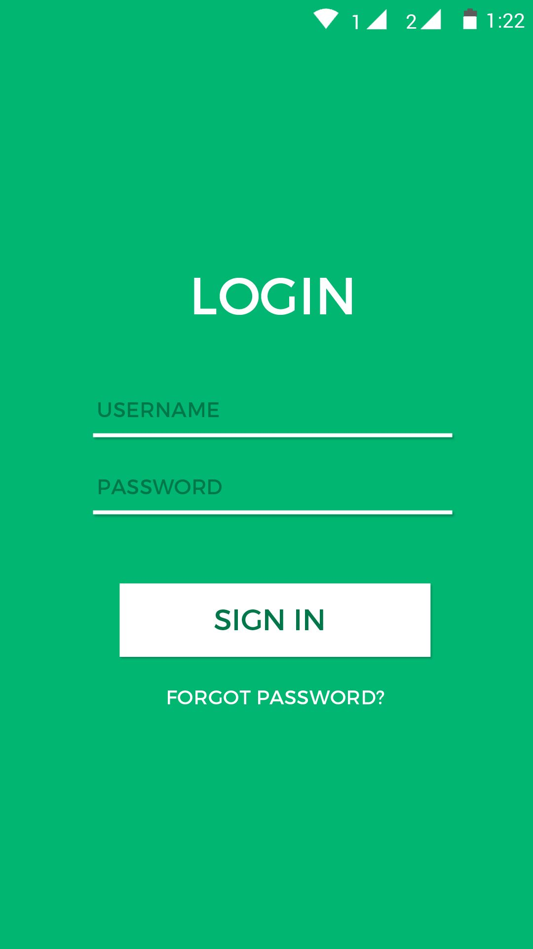
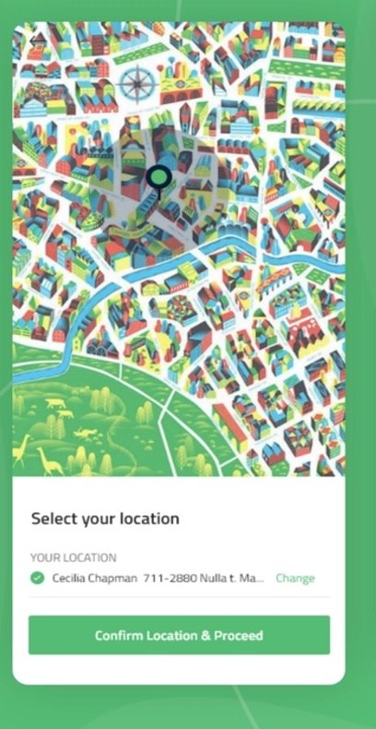
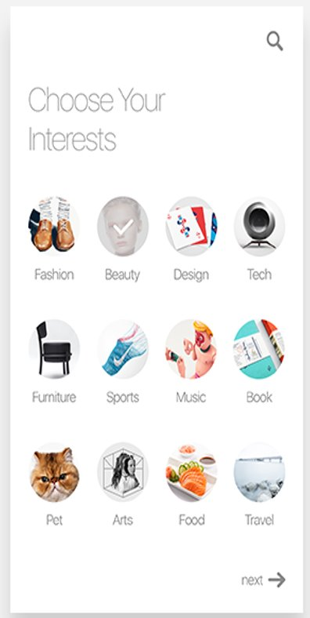
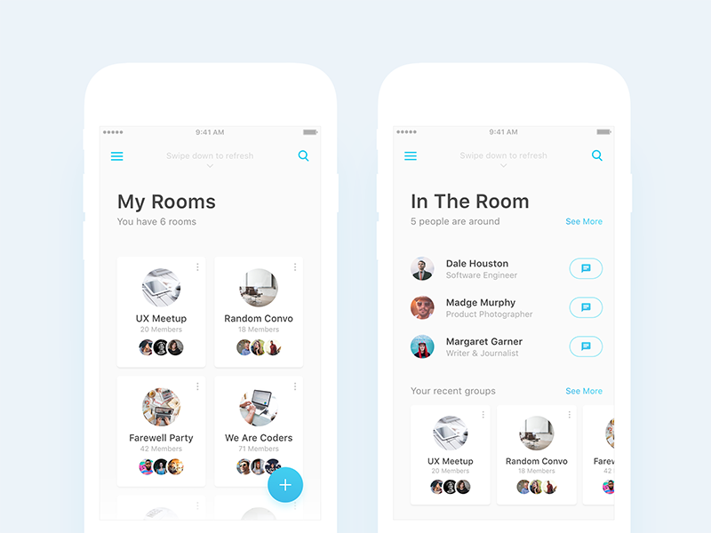
HOW TO USE

Slide 4

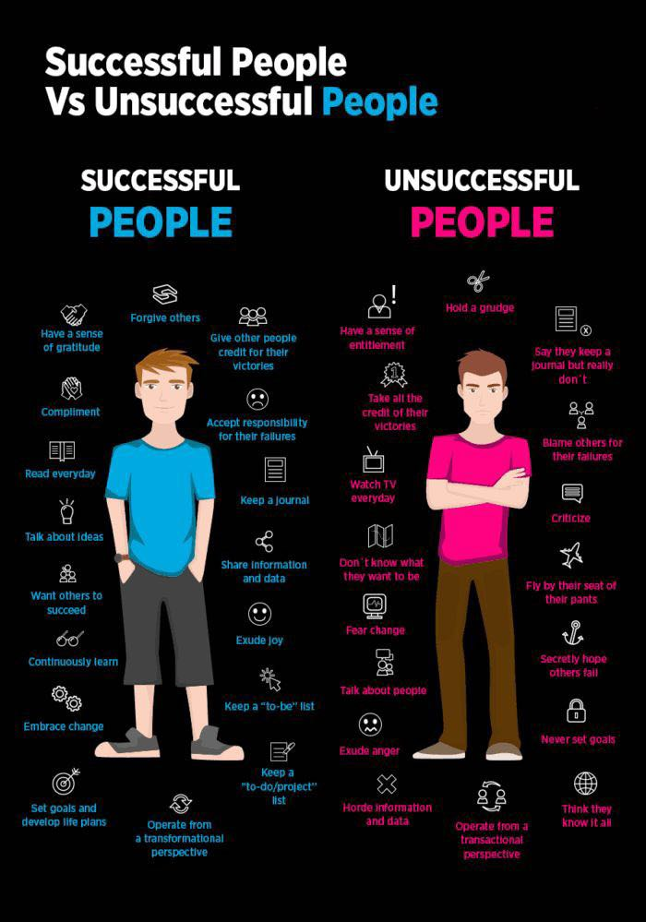
MISSION
Our mission in kin is mainly Saving time and energy as we know social media consumes most of our time so we designed kin to make the best use of our time.

Slide 5




Main Features
As you know, Kin is a social media platform that is based on circles of interest, so, we have a list of main features to support this idea and lead to a great, user-friendly experience and benefit
REGION
Trust score
Multiple circles
tIMELINE

Slide 6


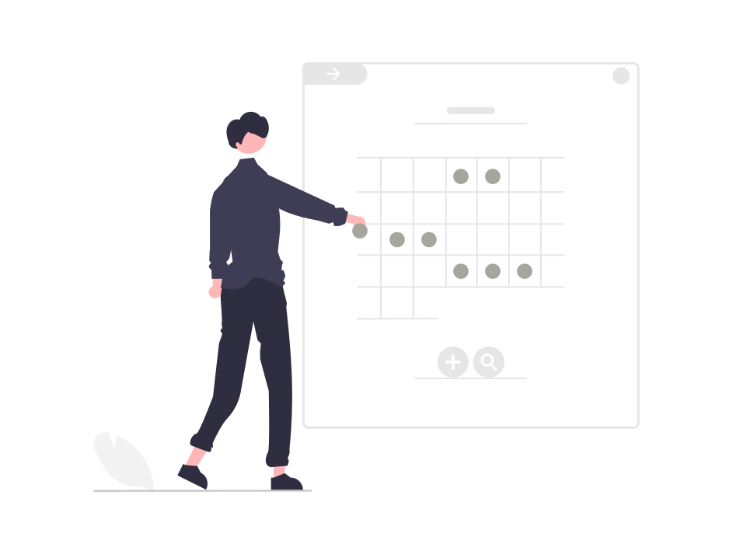
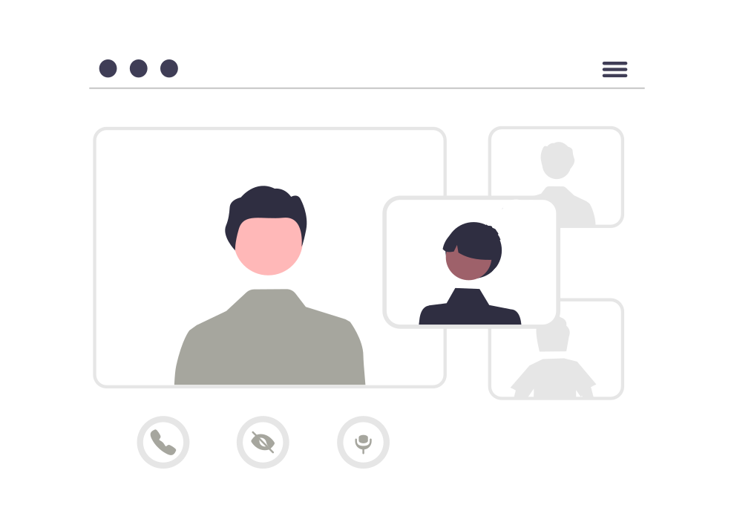
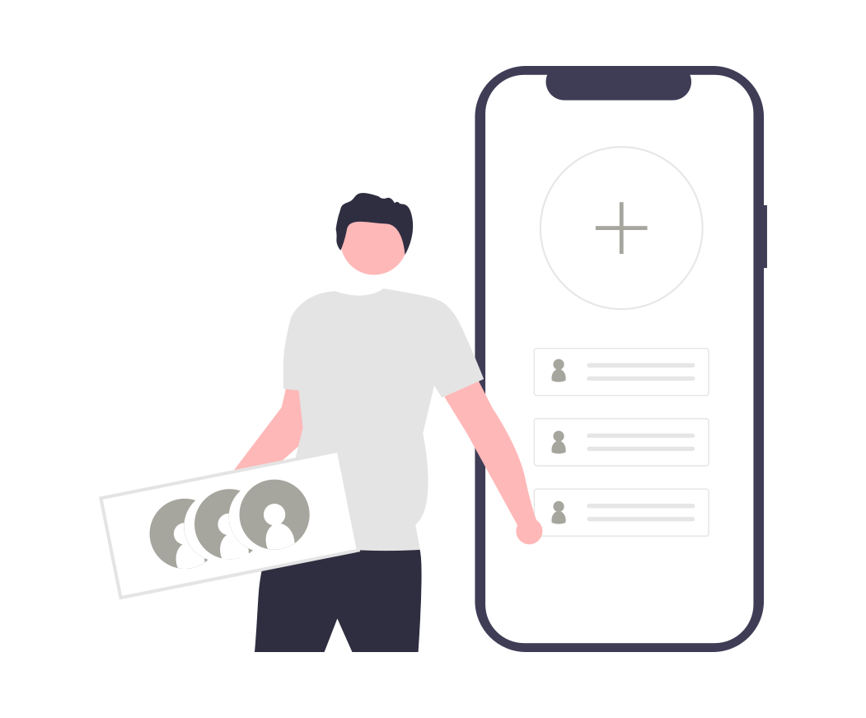


Main Features
Video chat
DM
Group chat
Announcements
Circles inside Circles
Support for content creators
Integrate with social media platforms

Slide 7
Development process
Through the next 6 months
Backend development
In parallel with UI/UX design & development
The first release will be after 6 months from now, including the main features.
The next update will be after 12 months from now, including:
Web app version
IOS app version
Fixing and working on more Features

Slide 8
FUTURE PLANS(VISION)
Our vision is to produce high-quality service that is affordable and flexible to our clients. We want to make our clients happy by creating a world-class mobile app that will definitely help them to improve their social and practical life, we also want to add more features in the future to the application like:
Adding our application to new platforms like IOS and Web
Focusing more on the education part of the application such as making partnership with companies like Udemy, Coursera and Udacity to provide courses in our educational groups so it will help to get more students engaged with our product
We also have ideas about arranging events and workshops in universities to help students involve with each other in their interests
Provide verified experts in each interest circle or group
Provide a monthly gathering to help our users know each other more
Provide a VR meetings in each circle of interest

Slide 9
Costs per month
Managerial positions | 12,000$
HRs & PRs positions | 4,000$
Development team | 20,000$
Marketing team | 6,000$
Managerial costs | 1,500$

Slide 10
THANK YOU
206-555-0146
hr@kinsoftware.com
www.kin.com

